Slide 1
CHAPTER 4: DESIGNING MOBILE APPLICATION INTERFACE
OVERVIEW
THE ELEMENT OF MOBILE APPLICATION DESIGN
INTERACTION DESIGN
FIRST SKETCH OF AN APPS
FINDING THE RIGHT DESIGN FLOW
DYNAMIC DESIGN IN MOBILE APPLICATION
DESIGNING FOR VISUAL APPEAL
DESIGNING APPS FOR SIMPLICITY AND USABLE BY ALL AUDIENCE

Slide 2
OVERVIEW
A mobile user interface (mobile UI) is the graphical and usually touch-sensitive display on a mobile device, such as a smartphone or tablet, that allows the user to interact with the device's apps, features, content and functions.
Mobile user interface (UI) design requirements are significantly different from those for desktop computers.
The smaller screen size and touch screen controls create special considerations in UI design to ensure usability, readability and consistency

Slide 3
OVERVIEW
In a mobile interface, symbols may be used more extensively and controls may be automatically hidden until accessed.
Users have to be able to understand a command icon and its meaning whether through legible text or comprehensible graphical representation
A mobile app that doesn't incorporate sound design principles is destined to fail. Users want an app that is familiar and predictable. ... Throughout the mobile application design process, strive to keep the UI as intuitive, responsive and user-friendly as possible

Slide 4
ELEMENT OF MOBILE APPLICATION DESIGN
BE CONSISTENT
Your app must follow a general theme.
If you add heterogeneous elements and you try to mix them together the general aspect won’t be so pleasant.
For avoiding such a mistake it is essential to set a goal from the start and to remain loyal to that idea.

Slide 5
ELEMENT OF MOBILE APPLICATION DESIGN
KEEP IT SIMPLE
Be careful not to create the sensation that customers need an instruction manual for using your app.
Keep in mind that every activity needs to be intuitive.
In case of a more complex task, you should divide the procedure into simpler stages.

Slide 6
ELEMENT OF MOBILE APPLICATION DESIGN
DON’T USE UNNEEDED INFORMATION
You have to take advantage of the essential information without overloading your app with unnecessary content.
Stay away from the dangerous position where your users will get bored and overwhelmed by the unwanted data provided by your app.

Slide 7
ELEMENT OF MOBILE APPLICATION DESIGN
AVOID AMBIGUITY
Everything needs to be as clear as possible, without the possibility of misinterpretations.
Eliminate the sections that can confuse users and help them understand how to manage your app in the most efficient way.

Slide 8
ELEMENT OF MOBILE APPLICATION DESIGN
BE FLEXIBLE
You need to keep in mind that humans also make mistakes.
Try to predict every wrong move that can occur and to allow them to reverse that action in order to follow the correct path.
Make your users happy with the way they interact with your app.

Slide 9
ELEMENT OF MOBILE APPLICATION DESIGN
SET REUSABILITY
Be sure that you use all customers’ data for avoiding repetitive tasks.
If they completed some necessary stages then you should save those results for further procedures.
If they need to enter the same data or to tap on the same buttons over and over again, you risk to annoy them.

Slide 10
ELEMENT OF MOBILE APPLICATION DESIGN
COLOR
A simple color could change everything.
Take a look at the scheme below and think about your users, their location, and their characteristics.
This way you will find the right complex of colors to match your app’s style.

Slide 11
ELEMENT OF MOBILE APPLICATION DESIGN
FONT
Funny app or game using a hilarious font will enhance the comic effect.
Serious app which presents real facts from the economic world then make sure that the typography chosen will reveal the gravity of the news presented.
Using too many font is confusing to the reader in typography

Slide 12
ELEMENT OF MOBILE APPLICATION DESIGN
ICONS
Create a great impact for the overall perception of users about your app.
There are various types of icons :
App Icons – for representing an app;
Clarifying Icons – explain certain tasks;
Interactive Icons – used mainly for navigation;
Decorative Icons – created for a more attractive look;
Need to be clear and to express exactly the type of action you are waiting for your customers.
Avoid similarities that can generate confusion or hesitation.

Slide 13
ELEMENT OF MOBILE APPLICATION DESIGN
NAVIGATION
In every moment they have to know where they are and the next step required for the wanted activity.
Use every instrument you have for guiding them and for describing the necessary steps they need to make for achieving their purpose.
You have to find the right balance between interactivity and simplicity but keep in mind that a tangled interface isn’t benefiting from any type of app, not even for puzzle games.

Slide 14
INTERACTION DESIGN
Interaction Design (IxD) is the design of interactive products and services in which a designer's focus goes beyond the item in development to include the way users will interact with it.
Thus, close scrutiny of users' needs, limitations and contexts, etc. empowers designers to customize output to suit precise demands.
It focus on a user-oriented field of study that focuses on meaningful communication of media through cyclical and collaborative processes between people and technology.
Successful interactive designs have simple, clearly defined goals, a strong purpose and intuitive screen interface.

Slide 15
Guideline interaction design
Match the keyboard with the required text inputs.
Gestures and Hardware
Don’t hide Password
Display the search field.
Ask for permissions in-context.
No Splash Screen
Orientation
Forms Short and Sweet
Test the app on Mobile
Make Navigation Intuitive
Filter and sort options.

Slide 16
FIRST SKETCH
use pen and paper
draw your App screens
Brainstorm – all ideas
plan navigation and features visually

Slide 17
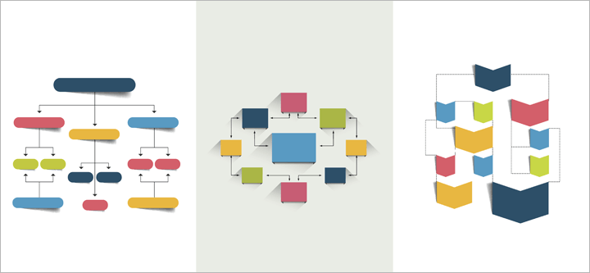
Design flow
Design flows are the explicit combination of electronic design automation tools to accomplish the design of an integrated circuit.

Slide 18
Rules of Design
Leave Conventions on The Side
Mobile design is so far different from web design. It has its rules and requirements. So, if you are designing mobile apps, free yourself from all the conventions and standards that exist in web design.
Less is More
People want everything simple, clean and clear today. They want intuitive mobile apps that are easy to explore and navigate.
Fun, Fun & More Fun
If you are working on a mobile app, to make it fun include cool buttons, fonts, textures and 3D effects and wrap it all up in beautiful colors with solid disposal of elements. Minimalism in colors is a trend now. Use more moving elements.

Slide 19
Rules of Design
Take Care of Screen Size
Designers should consider how people hold their phones and according to that make a good disposal of all primary navigation buttons. It needs to be comfortable for user’ thumbs, to give you a thumb up.
Swiping
Tinder got enormous popularity because of this feature. Swiping brings interaction and movement, and it is much more interesting than the usual tapping.

Slide 20
KEEP IN YOUR MINDS WHEN DESIGN
Set your target audience and design core features accordingly.
Provide specific functionalities, ones that are exclusive for mobile.
Be open to suggestions that users will give you. Don’t follow only your ideas, feedback from the people that are using your app is precious and consequently will provide you with the opportunity to improve.
Be sure that your mobile app is valuable for users. That helps them in something real and that they don’t regret installing it.

